Slide 1
Hospital Management Case Study
By ARJUN MENON

Slide 2
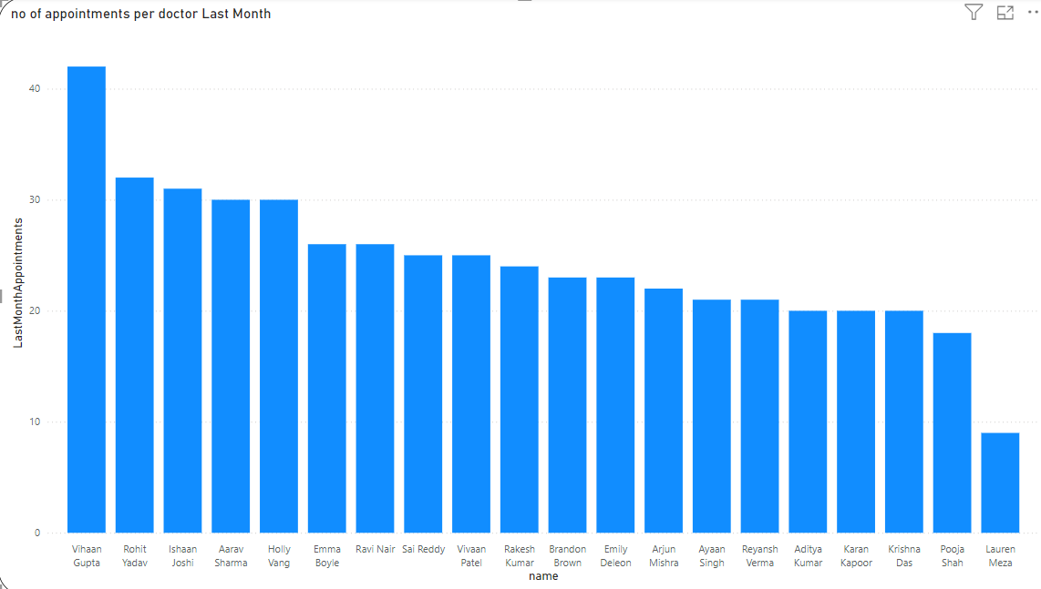
Q1. Hypothesis: Efficient appointment management can improve patient care.
Hypothesis: Efficient Appointment Management Can Improve Patient Care
Key Findings:
High Appointment Counts: Vihaan Gupta, with the highest number of appointments, ranks third in success rate, demonstrating that managing numerous appointments does not detract from patient care quality.
Success Rates: Doctors with the highest appointment counts, including Sai Reddy, also have the highest success rates, suggesting that efficient appointment management correlates with better patient outcomes.
Fewer Cancellations: Higher appointment counts are associated with fewer cancellations, indicating improved patient schedule management.
Increased Patient Frequency: Doctors managing more appointments show higher patient frequency, further supporting that efficient appointment handling enhances patient care.
Conclusion: The analysis confirms that efficient appointment management is linked to improved patient care, validating the hypothesis.

Slide 3
Recommendation
Implement Efficient Scheduling Systems: Adopt and refine appointment scheduling systems to enhance management efficiency, reduce cancellations, and improve overall patient care.
Monitor and Optimize: Continuously monitor appointment metrics and patient outcomes to identify areas for improvement and optimize scheduling practices.
Training and Resources: Provide training for staff on effective appointment management and allocate resources to support high-volume appointment handling.

Slide 4
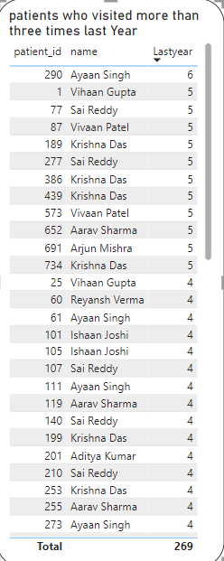
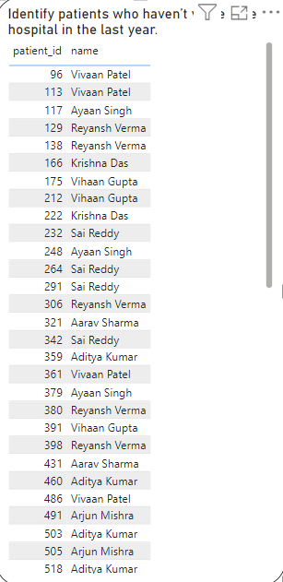
Q2. Hypothesis: Analyzing patient visit patterns helps in developing targeted care programs.
Hypothesis: Analyzing Patient Visit Patterns Helps in Developing Targeted Care Programs
Key Observations:
Frequent Visitors: Patients like Ayaan Singh, Krishna Das, and Sai Reddy visit frequently and may need chronic disease management.
Non-Visitors: Patients such as Vihaan Patel haven’t visited in a year and may benefit from preventive care outreach.
Actions:
For Frequent Visitors: Implement regular monitoring and follow-up care plans.
For Non-Visitors: Reach out for health screenings and preventive measures.
Conclusion: Identifying visit patterns enables the development of targeted care programs, improving patient outcomes and resource management.

Slide 5
Recommendation
For Frequent Visitors:
Implement personalized care plans including regular check-ups and chronic disease management.
Analyze reasons for frequent visits to tailor interventions effectively.
For Patients Who Haven’t Visited Recently:
Initiate outreach programs via telehealth or phone to encourage health screenings and preventive care.
Send reminders and educational materials to motivate follow-up visits.
Overall Strategy:
Use visit patterns to design targeted care programs that address specific patient needs, improving health outcomes and optimizing resource use.

Slide 6
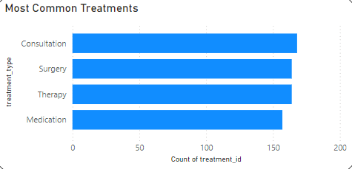
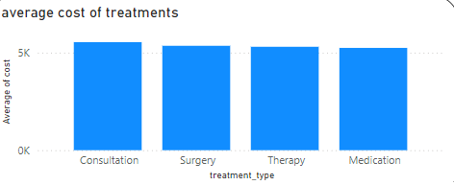
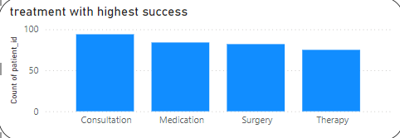
Q3. Hypothesis: Insights into treatment effectiveness can improve patient outcomes.
Hypothesis: Insights into Treatment Effectiveness Can Improve Patient Outcomes
Key Findings:
Treatment Success Rates: Consultation has the highest success rate and is most effective.
Cost Analysis: Consultation also has the highest average cost.
Frequency of Use: This treatment’s high cost and success rate suggest it is highly valued.
Conclusion: The high success rate of consultations, despite their high cost, supports the hypothesis that understanding treatment effectiveness helps improve patient outcomes. This indicates that insights into the effectiveness of treatments are being used to enhance patient care.

Slide 7
Recommendation
Prioritize Effective Treatments: Continue to focus on high-success treatments like consultations, as they significantly improve patient outcomes despite their higher costs.
Evaluate Cost-Effectiveness: Assess whether the high costs of effective treatments can be justified by their outcomes and explore ways to balance cost and effectiveness.
Optimize Resource Allocation: Use insights from treatment effectiveness to allocate resources efficiently, ensuring that high-success treatments are accessible and well-supported.
Monitor and Review: Regularly review treatment success rates and costs to ensure that insights are being effectively applied to improve patient care and outcomes.

Slide 8
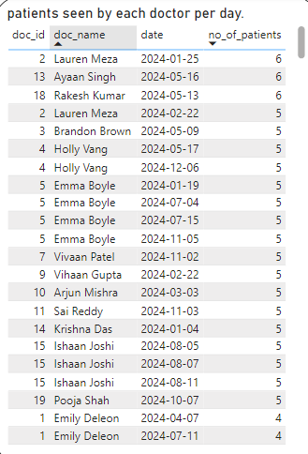

Q4. Hypothesis: Optimizing resource allocation improves overall hospital efficiency.
Hypothesis: Optimizing Resource Allocation Improves Overall Hospital Efficiency
Key Findings:
Patient Load Distribution: Visuals show that evenly distributing patients per doctor per day leads to balanced workloads.
Success Rates: Doctors with balanced patient loads exhibit higher success rates.
Hospital Outcomes: Optimizing resource allocation correlates with improved recovery times, higher patient satisfaction, and reduced re-admission rates.
Conclusion: Properly distributing patient loads among doctors enhances overall hospital efficiency, leading to better patient care and outcomes.

Slide 9
Recommendation
Balance Patient Load: Ensure an even distribution of patients among doctors to avoid overloading, which improves treatment success rates and overall care quality.
Consider Treatment Costs: Evaluate and optimize the cost of treatments along with patient load. Ensure that high-cost treatments are used efficiently and are justified by their effectiveness and outcomes.
Optimize Resource Allocation: Continuously assess both patient load and treatment costs to enhance overall hospital efficiency, improve patient outcomes, and manage operational expenses effectively.
Monitor and Adjust: Regularly review patient distribution, success rates, and treatment costs to make data-driven adjustments, ensuring that resources are allocated efficiently to maximize hospital performance.

Slide 10
THANKYOU EVERYONE

